Slide 1
THE RISE OF THE FLYING BOATS
This talk covers the introduction and use of the Short Bros flying boats in particular focusing on the route through Africa.
1925-31 Alan Cobham
1931-36 Setting the Scene – Mail Contracts
1937-39 Empire Airmail Scheme
1939-45 War Time Services
1945-50 Post War Services
Maps and Aircraft Movements from Peter Wingent African Route 1931-39 and Proud Sudan Airmails and Intercontinental Airmails – Africa.

Slide 2
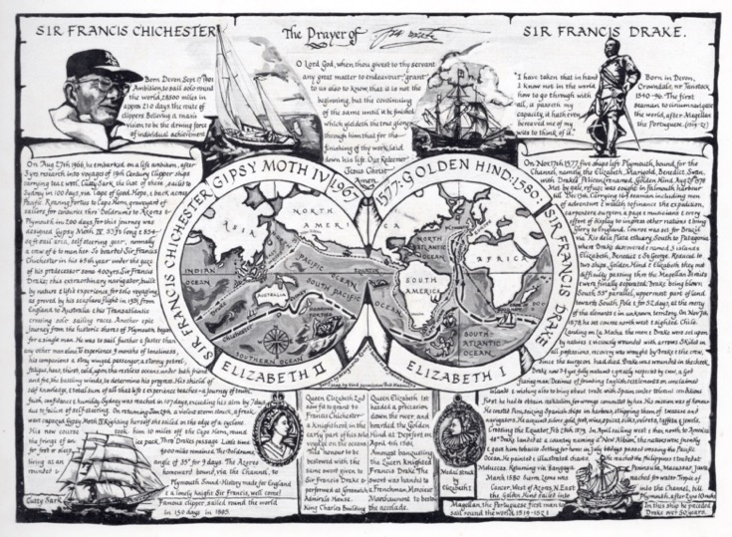
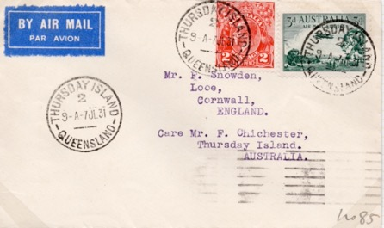
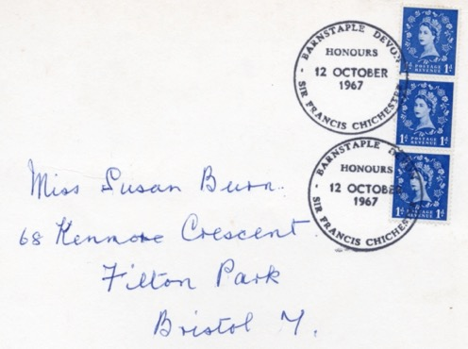
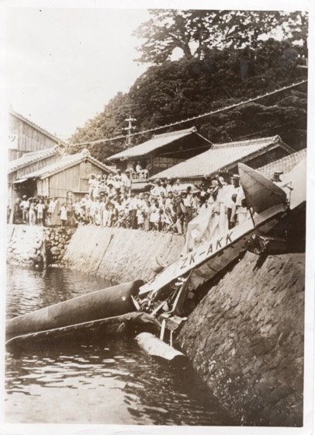
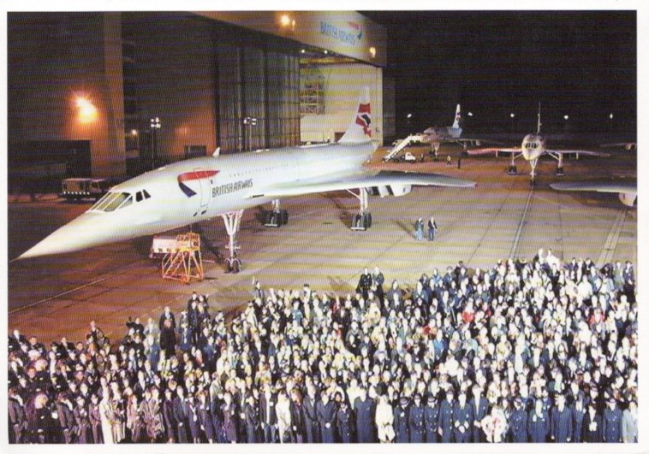

Slide 3
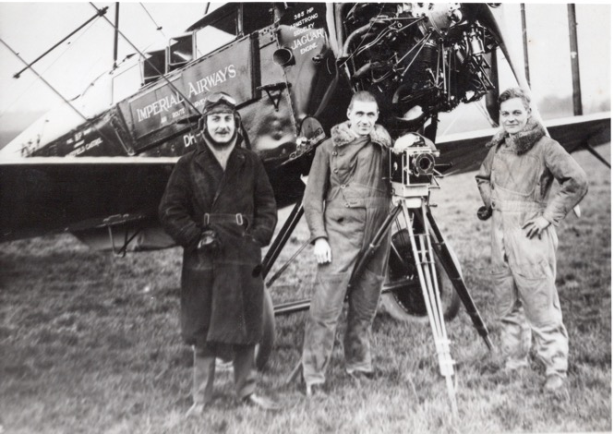
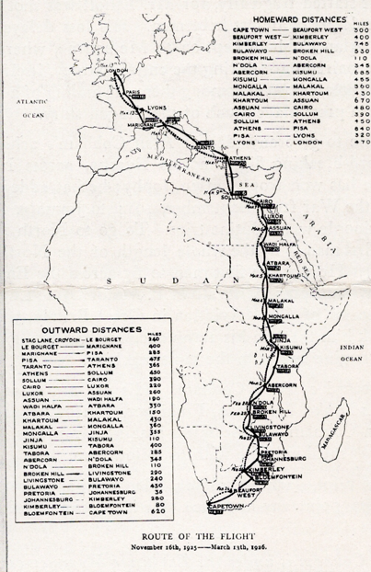
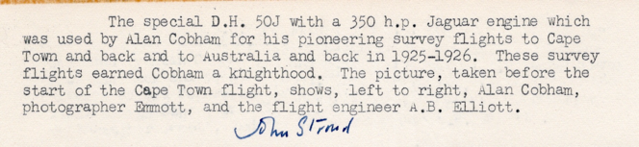
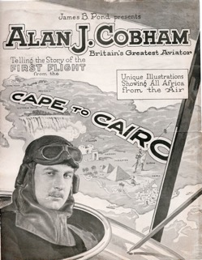
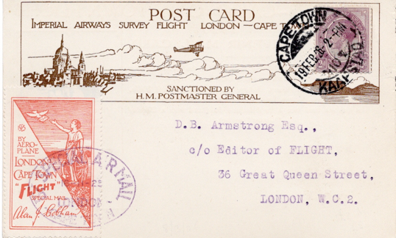
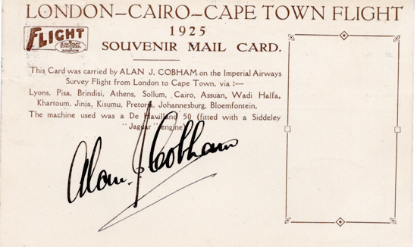
Alan Cobham Survey Flight Africa 1926

Slide 4
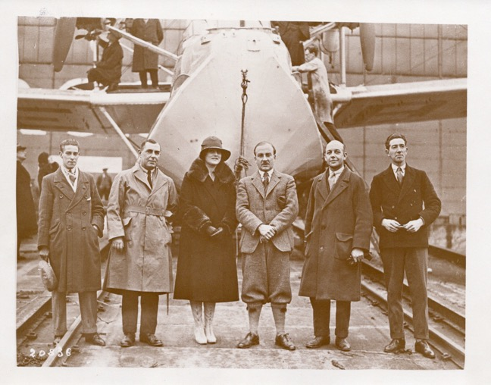
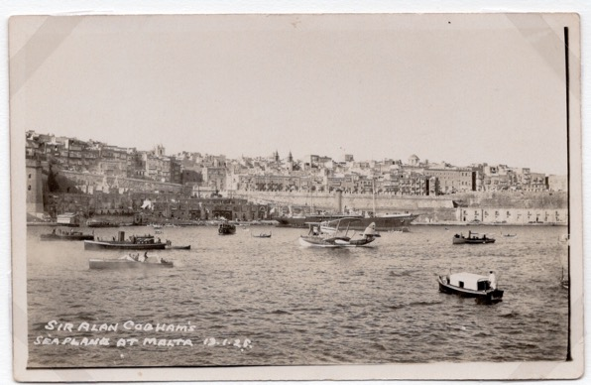
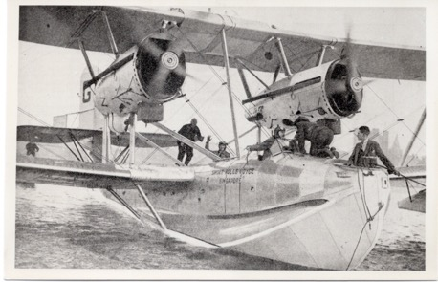
Cobham Blackburn Airlines Ltd – 1927/8 Flight around Africa
In May 1927 Cobham left DeHavilland to form Cobham Blackburn Airlines in April 1928.
At the behest of Imperial Airways he completed a 20,000+ mile around Africa leaving from the Medway on 17 November 1927.
His intention was to operate a regular air service to Africa.
Relying on Brackner’s assurance that Imperial Airways would be focusing on the routes through Europe to Cairo he was shocked by their announcement that their operations would be extended to Africa winding the Company up on 29 July 1930.
Preparing for a new flight around Africa.
Conway (Mechanic), Co-pilot Worrall, Lady Cobham, Alan Cobham, Green (mechanic) Donner (Cameraman)
Delayed by 2 months in Malta because of storm damage to the aircraft. Aircraft Short Singapore G-EBUP.
Return flight landed in Plymouth on 31 May 1928.

Slide 5
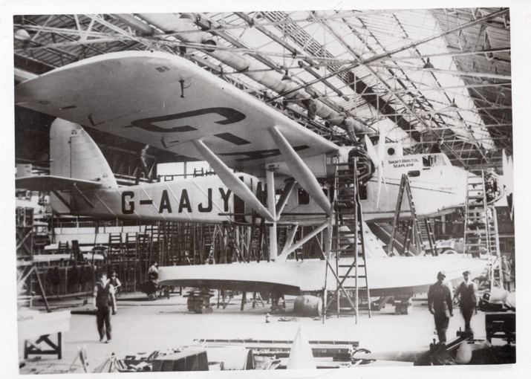
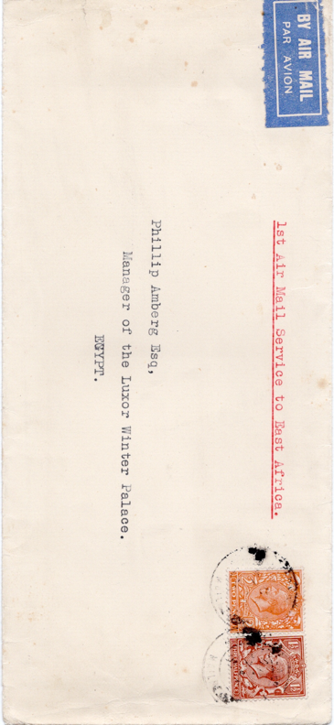
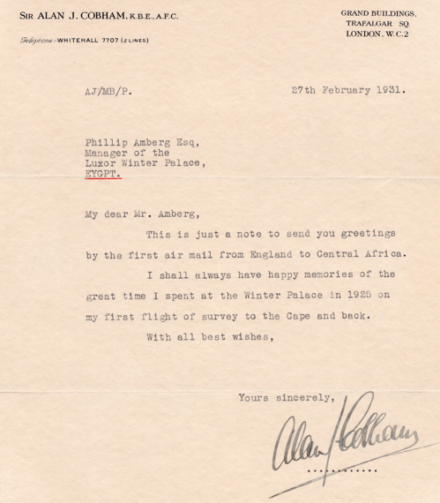
Alan Cobham – Africa Survey Flight 1931
Leaving Rochester on 22 July 1931 in a Short Valetta Seaplane G-AAJY.
Aim was to test the new seaplane and conduct a survey of the Congo region.
He returned in September 1931.
Flew over ‘Mountains of the Moon’ to lake Kivu 5,000 feet above sea level.
Distance flown 12,300 miles.

Slide 6
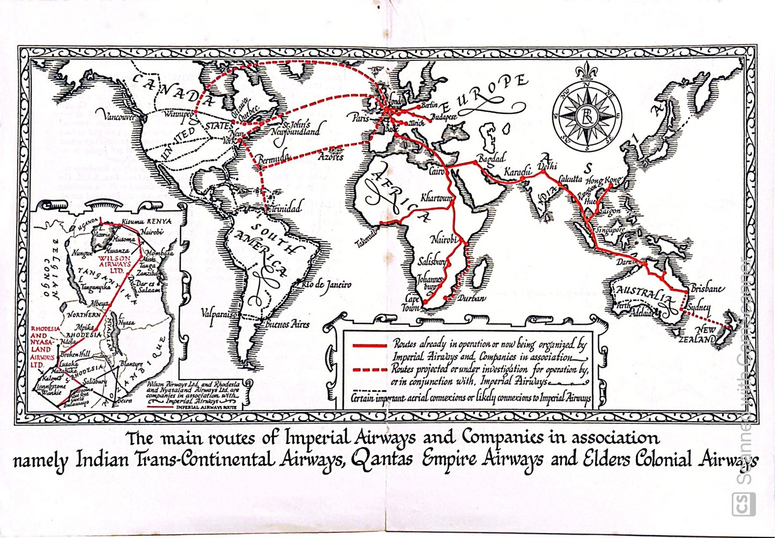
Imperial Airways Route Map prior to the Introduction of the Flying Boats

Slide 7
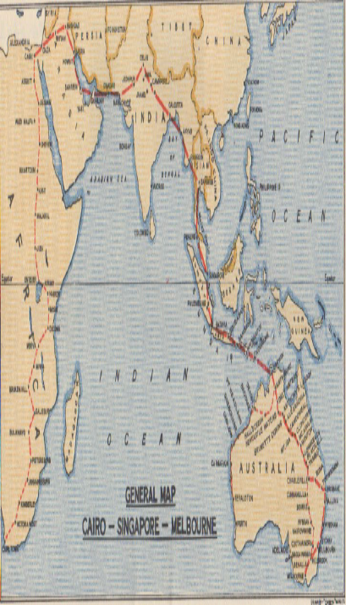
Imperial Airways Passenger Route Map 1935/6 – land plane service

Slide 8
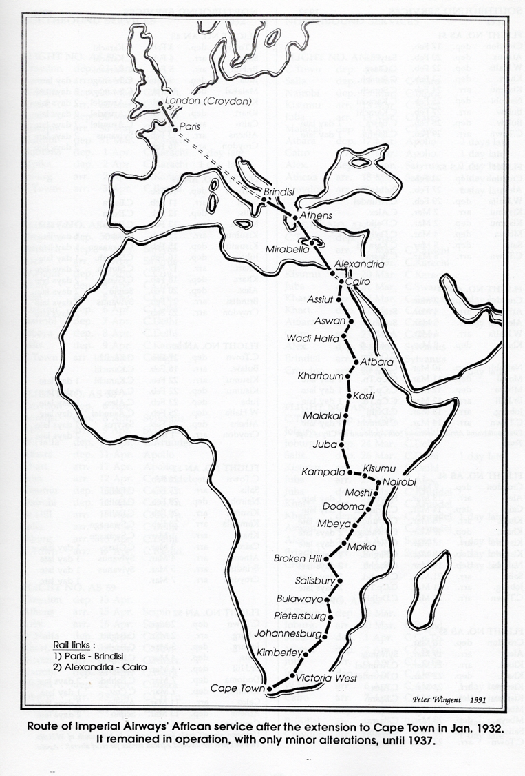
First Flight Extension of Service to Capetown
Map and comments on this page taken from Peter Wingent Movements of Aircraft on Imperial Airways African Route 1931-39.
Service AS41 was extended experimentally to Capetown to position and test aircraft over the new southern part of the route in preparation of the opening of regular services, which commenced in January 1932.
It was also the first southbound service of the ‘City of Delhi’.
Flight AS47 departing Croydon on the 20 January 1932 was the first regular service to Capetown arriving on the 2 February. The first return leaving Capetown on the 27 January 1932 arriving at Croydon on the 16 February 9 days late due to various incidents.
Alex Newall (British External Airmails to 1934) states that the GPO used AS41 as an opportunity to organize a special Christmas Mail announced on the 30 November the mail exceeding 60,000 items. Only mail cancelled at Croydon or Wilton Road was carried from London the rest being sent to Paris in advance.
The 5 stops in Sudan applying special cancellations provided by John Davies, a Liverpool Stamp Dealer. Sudan was one of the few countries to use them.

Slide 9
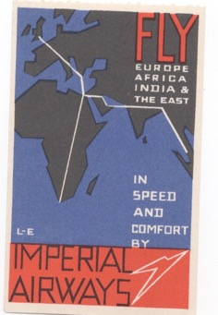
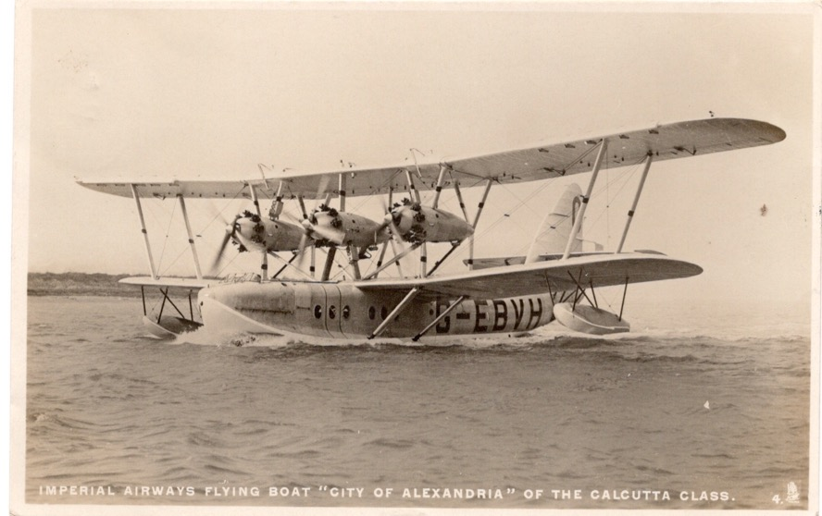
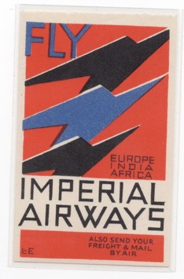
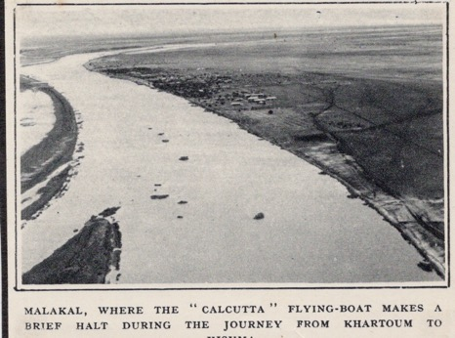
Calcutta Flying Boats Used on the Africa Service
Short S8 Calcutta Flying Boats used on the route. 14 passengers and 3 crew.
G-EBVH City of Athens renamed City of Stonehaven
Publicity Labels issued to affix to covers.

Slide 10
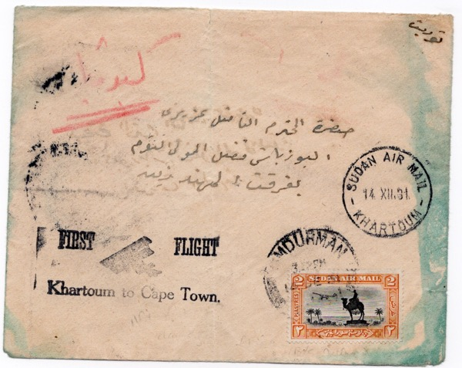
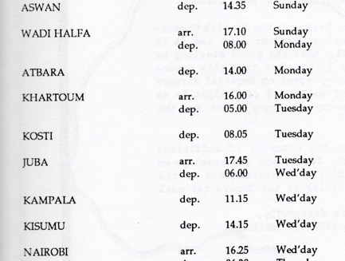
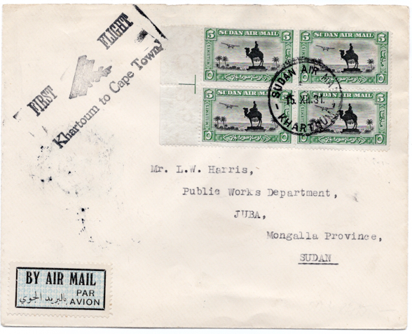
Service AS 41 – Experimental Extension to Capetown 9 December 1931
Service schedule through Sudan (Wingent)
Covers Carried from Khartoum to Juba internal to Sudan.
Airmail rates within Sudan and to Egypt were 20mm per 15 grammes

Slide 11
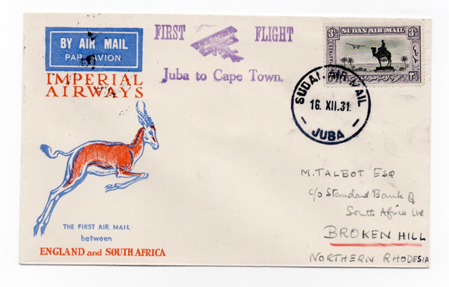
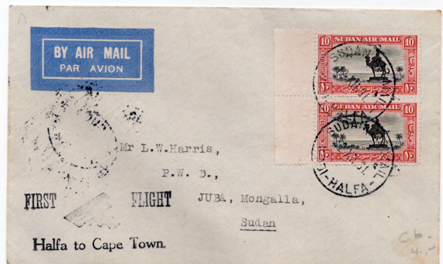
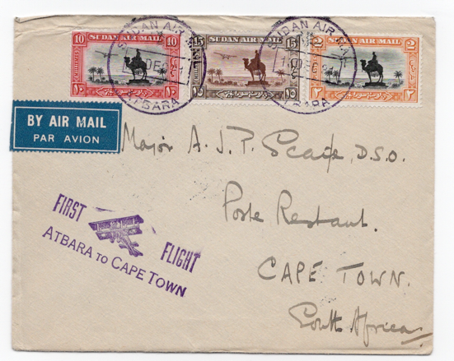
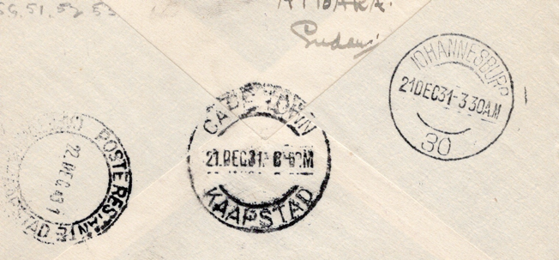
Postage to the UK and South of Sudan was 30 m/m per 15 grammes and to foreign destinations 35 m/m per 15 grammes.
Cachets used at Waidi Halfa, Juba and Atbara,
On majority of occasions mail was sorted at Jo’burg PO and backstamped before sending onto Capetown.

Slide 12
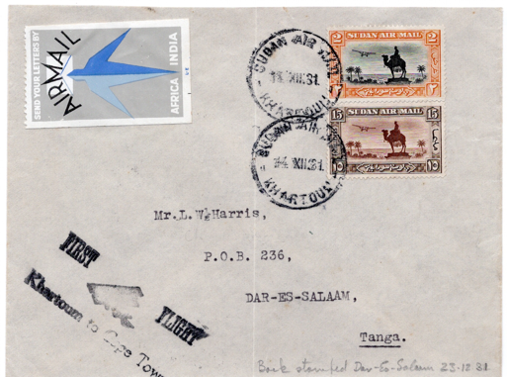
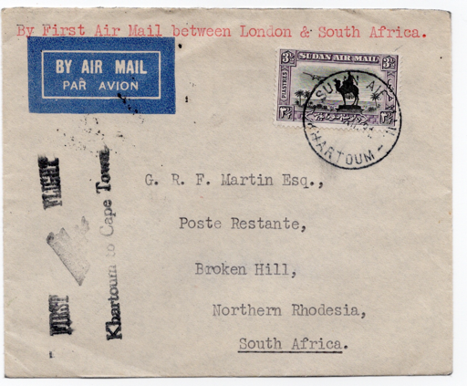
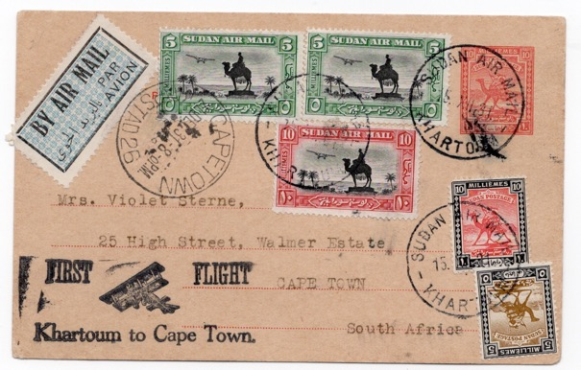
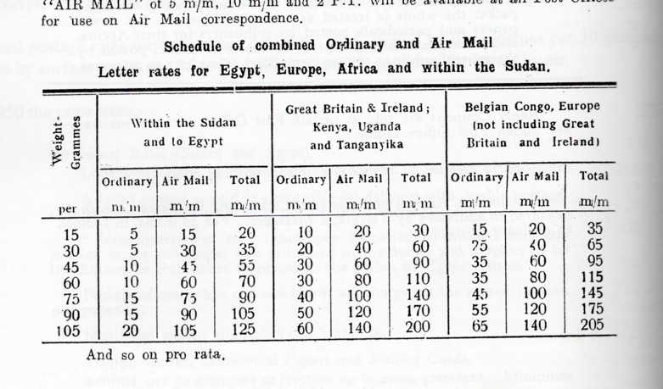
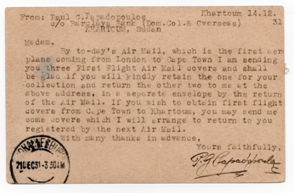
Postage surface 10 m/m plus air fee 35 m/m total 45 m/m.
Table taken from PH Sudan by Proud.

Slide 13

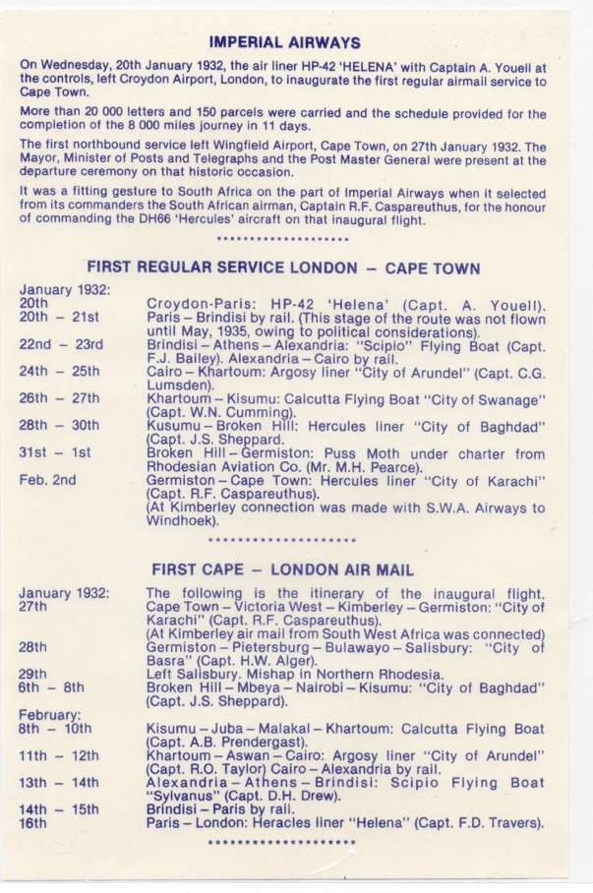
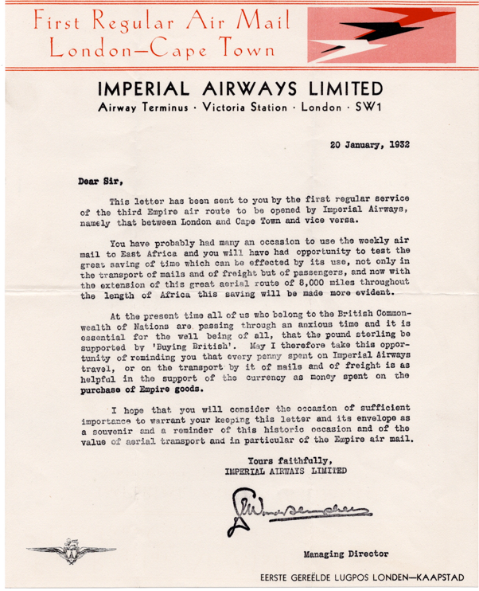
Flight AS/AN 47 First Regular Service Croydon – Capetown January/ February 1932
Imperial Airways Publicity letter to advertise the opening of the new service to South Africa.

Slide 14
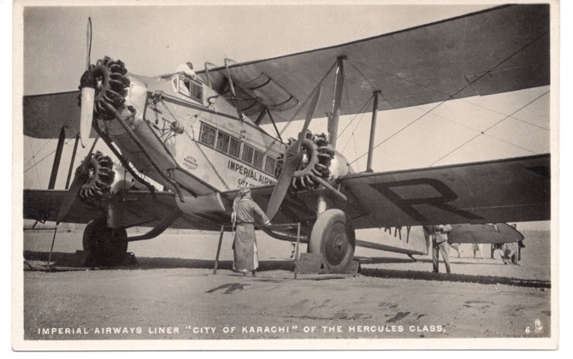
”to fly across Africa and back is no longer an adventure but an entrancing experience in which 8,000 miles of Empire unrolls beneath your armchair.”
Major Ewart Grogan at the Launch Luncheon Southampton.
Ewart Scott Grogan (1874–1967) was an English explorer, politician and entrepreneur. He was the first person in recorded history to walk the length of Africa from Cape Town to Cairo.
G-AARY City of Karachi used on the Germiston – Cape Town section.
DeHavilland DH 66 Heracles Class Crew 2. Passengers up to 8.

Slide 15
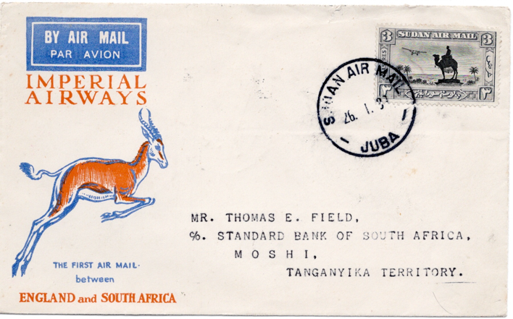
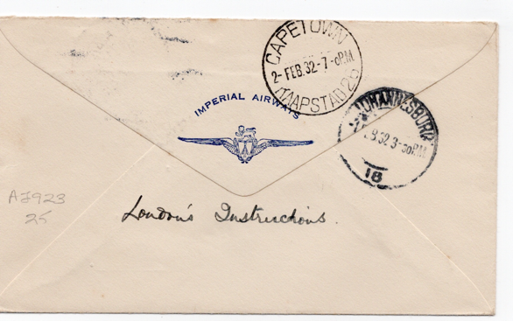
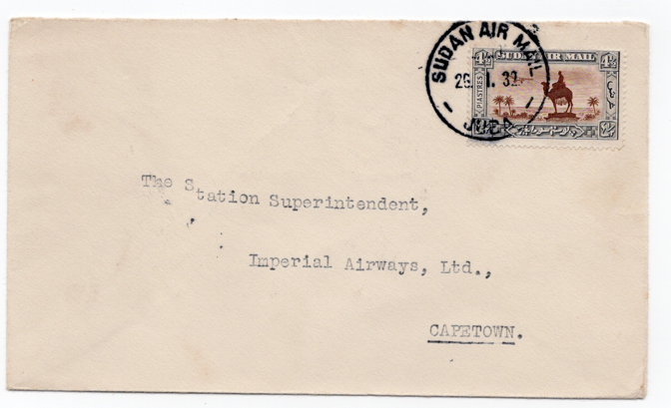
Official first flight cover from Juba, Sudan to Moshi in Tanganika.
The City of Arundel left Juba on 27 January arriving Moshi on the 28 January.
Imperial Airways Test Letter to Capetown arriving 2 February 2 days late.

Slide 16
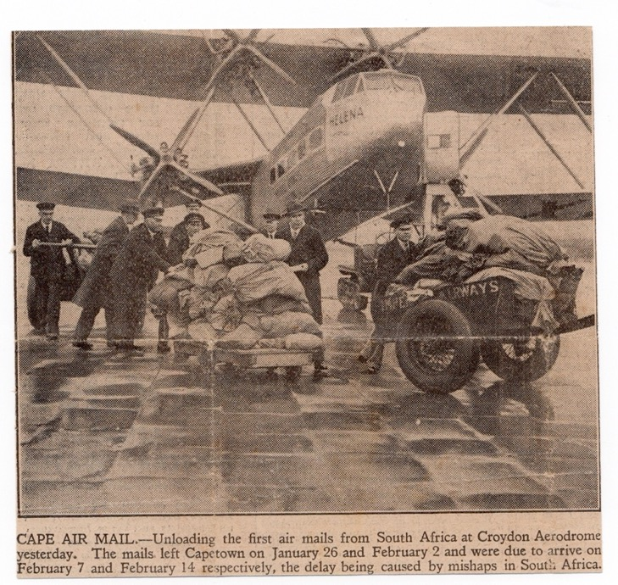
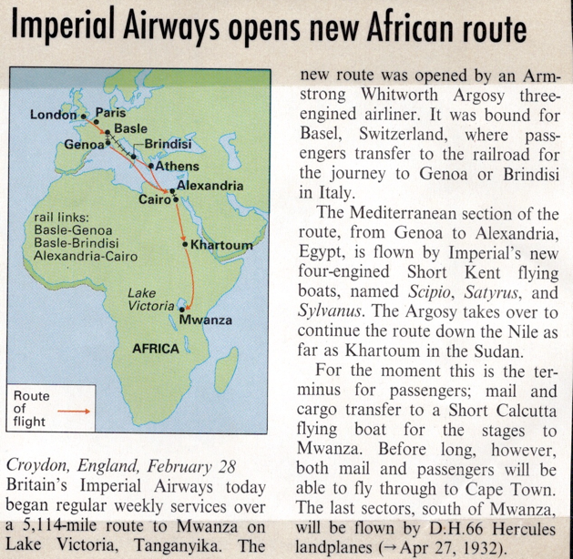
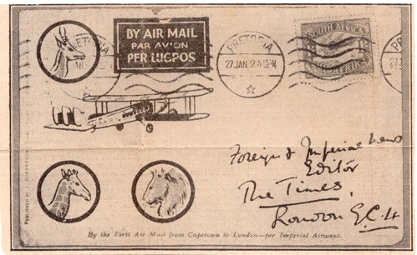
June 2020 Imperial Airways Gazette P7-10
British Airmail Society Website.

Slide 17
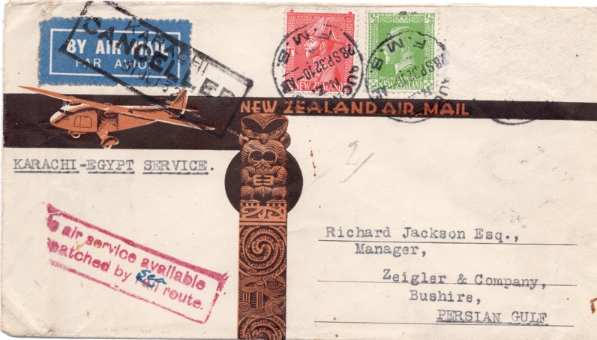
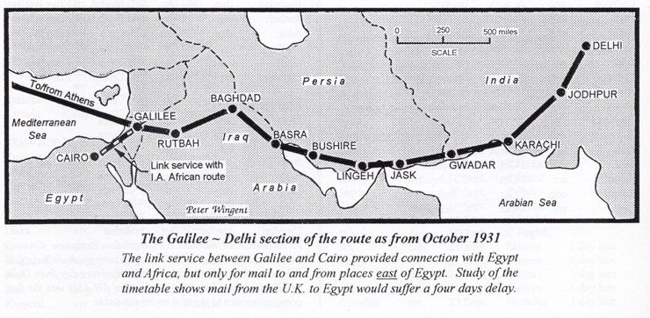
KARACHI – EGYPT AIR SERVICE FROM N.Z. 16 JUNE – OCTOBER 1932
A new partial air route commenced on the 16 June 1932. The first despatch of mail by sea from Auckland to Karachi connected to service IW173 that departed on the 27 July 1932 in Hanno arriving at Cairo on the 30 July. The airmail rate was 3d per ½ oz with an estimated 27-day transit time. From 1 June 1932 the surface rate reduced to 1d for first oz Empire and 2 ½ first oz UPU.
The original agreement between Imperial Airways and the Persian Government, for the route along the coast that the aircraft would fly over, was for 3 years.
The route commenced 30 March 1929, the Persian Government making it clear that at the end of the agreement they intended to impose an inland route.
Imperial Airways had no alternative but to negotiate a new route along the Arabian coast from Basra via Bahrein, Sharjah and Gwadar to Karachi. The first service over the new route was IW183 that left Karachi on 5 October 1932.
Cover dated the 28 September 1932 would have arrived after the start of the new route when the air service was no longer available. The airmail label was cancelled and a cachet applied to confirm that the cover was being sent on by sea.
Stamps to the value of 1 ½ d applied to the cover plus one subsequently removed. Backstamp illegible.

Slide 18
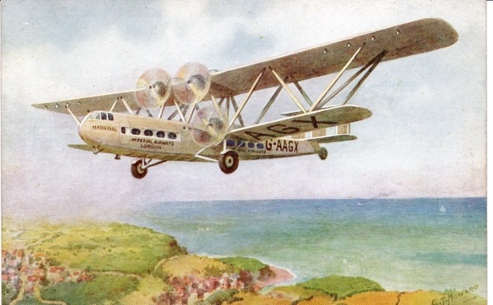
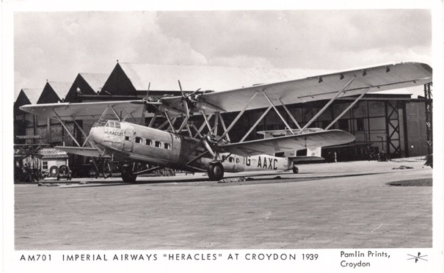
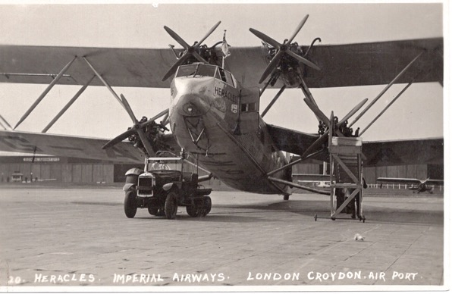

Imperial Airways HP42 Heracles Class Airliners
Crew 3 and up to 38 passengers carried. Africa configuration 20 passengers and more luggage space.
Type consisted of G-AAXC Heracles; G-AAXD Horatius; G-AAXE Hengist and G-AAXF Helena.
Service AS89 9 November 1932 first southbound service by an HP42 (Horsa) Cairo – Kisumu.

Slide 19

Imperial Airways leaflet dated May 1932 showing weekly flights to Africa on Wednesdays with the return service from Capetown also departing on Wednesday.
Tickets to Khartoum currently £67 single and £120 12/- return. In today’s money depending on the measure used that would be £6-9,000 one way!

Slide 20






Introduction of New Aircraft/ Mail carried prior to first acceleration of service.
Service AN100 left Khartoum on 7 February 1933 in Horsa.
Arriving Brindisi 10 February in Sylvanus.
Last service before Cairo to Alexandria section was flown.
Train from Brindisi to Palermo arriving 11 February.
Rate 30m for first 20g.
AN105 Khartoum 13 March 1933 in Hadrian. Satyrus from Alexandria to Brindisi then Horatius to Croydon arriving 19 March.
First northbound Africa service by Hadrian.
25m first 20g.
Service AS128 (Southbound) Malakal to Juba arriving 14 August 1933 in Horsa.
Internal Postage Rate 15m up to 15g.
Crew 4. Passengers up to 15. Used on the Alexandria – Brindisi section.
Notes:
. Used on

Slide 21






First Acceleration of Service 26 April/3 May 1933
Northbound – Paris – Brindisi by rail and Alexandria – Cairo by rail.
Southbound – Brindisi – Paris by rail.
Service AN110 departed Juba 17 April 1933 in Horsa.
Alexandria to Brindisi in Scipio arriving 21 April. Backstamp Brindisi 21 April.
Train to Germany arriving 24 April.
Penultimate service prior to acceleration.
Rate 30m up to 20g.
Service AN116 left Khartoum 30 May in Horsa to Cairo arriving 31 May. Sylvanus carried mail to Brindisi then Horatius to Croydon on 6 June arriving 3 Days late.
First northbound Africa service by Andromeda.
By sea to New York arriving 13 June 1933. Rate 55m to 20g then 48m per additional 20g.
Service AN119 Khartoum 19 June in Hadrian. Alexandria 22 June in Satyrus arriving in Brindisi same day.
Train to Germany. Double rate 53m. 30m up to 20g then 23m each additional 20g or part.
Ex vessel ‘Ubena’ of the German East Africa Line hence Sudan Quays postmark.

Slide 22



Acceleration of Service from 4 October 1933
Northbound schedule acceleration to allow arrival at Cairo one day earlier to enable immediate connection with eastbound Indian services (previously 5-day delay).
Postcard dated 11 November 1933.
Service AN140 departed Khartoum 13 November arriving Brindisi 16 November 1933.
Hanno to Cairo.
Postage Rate 30m for first 20g.
Manuscript on reverse ‘Khartoum November 1933. He looks dashed hot and annoyed doesn’t he?’
Aircraft Hadrian – used on AS138/AN138 in Khartoum 24 and 30 October 1933

Slide 23





Impact of MacRobertson Air Race 20 October 1934 on Civil Aircraft Production
DH88 Comet
Douglas DC2
Boeing 314

Slide 24



Postal Notice of Rate Change from November 1934
Service IE303 departed Croydon 5 January arriving in Darwin 16 January 1 day late despite despite 2 different aircraft having engine trouble culminating on 16 January the Athena made a forced landing on a beach 60 miles east of Darwin.
Postage to Australia was 1/3 per ½ oz hence tax charge of 1/6 double the difference.

Slide 25



Imperial Airways Timetable dated December 1934.
New timetable required as services were now increased to 2 per week. The extra service leaving Croydon on Sundays from the 30 December to Johannesburg with onward connections to Capetown initially by rail.

Slide 26


Imperial Airways Mozambique – Australia December 1934
Imperial Airways used this new service to link with the existing services within Africa via Cairo. The special first flight covers
were distributed throughout the Empire.
Registered cover dated 26 November 1934 Tete, Mozambique to Australia Route
SNAM – Service de la Navigation du Aerienne de Madagascar – Mozambique -
Beiro – Intranbaue – Tete –Broken Hill.
Imperial Airways Service AN196 Broken Hill 6 December to Cairo arriving 10 December. The first service to connect with
Service IE298 departing 13 December in Horsa. Then Athena to Darwin arriving 17
December.

Slide 27


First Regular Service Introduced Singapore to Australia connecting with Africa Service at Cairo December 1934
AN196 left Kisumu on 7 December 1934 arriving at Cairo on the 10 December. The mail was transferred onto the Eastern Service IE298 in Horsa departing 13 December to Singapore. The Athena then carried the mail to Darwin arriving on the 17 December.
Post Office instructions stated that mail for countries where no air connections existed should be marked to the nearest country the air service carried and thence by sea. The postcard was flown by internal air service to Sydney and then sea arriving 21 February 1935.
Postcard rate 60c from Kenya.
HP 42 ‘Helena’ in flight. On 20 January 1932 used to inaugurate the first service from Croydon to Capetown. (London-Paris Section).
Hanno and Horsa were used for the 1934 flight.

Slide 28


London – Brindisi Air Service – late posting of Mail May 1935
Imperial Airways obtained the agreement of the French and Italian Governments for a supplementary Sunday Air Service to Brindisi saving a day in transit time.
Operated by DH86A aircraft only urgent mail, freight and passengers could be carried.
Flight AS240 left Croydon 15 May in Heracles, departing Brindisi on 17 May in Sylvanus where this cover joined. Horsa, Artemis and Atalanta arriving at Capetown on 24 May.
Cancellation Williamstown 25 May. Redirected to UK with manuscript on reverse ‘ returned by ordinary mail. Received 18 June 35’.
Air Letter Rate 6d per ½ oz from November 1934. Service ended October 1935.

Slide 29




Short Brothers L.17 G-ACJJ ‘Scylla’
Built at Rochester with Jupiter engines by the Bristol Aeroplane Factory.
Weight fully loaded 143 tons. Speed 130 mph. With a crew of 4 and up to 39 passengers.
Used mainly on the European Services.
Lunch whilst flying to Paris.

Slide 30





Armstrong Whitworth AW.15 ‘Atalanta’ Class
Designed for Imperial Airways to operate on its India and Africa Services and in particular on the route between Kisumu and Cape Town. 8 aircraft were ordered off the drawing board. Maximum speed 150 mph. Crew of 4 with up to 11 passengers.
G-ABTG Amalthea
G-ABPI Arethusa
G-ABTI Atalanta
G-ABTL Astraea

Slide 31




West Africa Feeder Service 1936-39
First Service commenced on 15 February 1936, initially from Khartoum to Kano eventually extending by 1939 to Takoradi on the Gold Coast. The mail was sent via the ‘duplicate’ service from Croydon on Sunday arriving in Khartoum on Wednesdays.
Flight WAS2 (WAS1 was a survey flight with no mail carried).
AS317 Croydon 9 February 1936 arriving Khartoum 14 February.
WAS2 Khartoum depart 15 February arriving Kano 16 February.
De Havilland DH86B Diana class used on feeder services. Two Pilots and a radio officer with up to 10 passengers. Daedalus was used on WAS2.

Slide 32

The Empire Airmail Scheme
The British Government announced the scheme on the 20 December 1934 to be introduced in stages beginning in 1937. Mail would be carried at the ‘all up’ rate of 1½ d per ½ oz between most countries in the Commonwealth. To deal with the enormous expected uplift in the amount of mail carried Imperial Airways ordered 24 large engined flying boats from Short Brothers to be known as type S-23 they could carry a mail load of almost 3 tons in addition to 15 passengers and a crew of 5.
The Centaurus was one of the first to be built being issued with its Certificate of Airworthiness on the 28 October 1936.

Slide 33


The Flying Boats
Postcard showing the interior of the S23 Flying Boat
Press Photo of a new Flying Boat at the slipway of Shorts at Rochester – one of the first 28 to be built under the initial contract from Imperial Airways.
Top speed 200 mph. Taking up to 24 passengers by day and 16 by night.

Slide 34



Captain HWC Alger Imperial Airways/BOAC Pilot
Significant Imperial Airways Flights –
April/May 1931 Experimental Flights to Australia.
December 1931 – Final Survey flight Cairo - Cape with Major Brackley. Delivery of Christmas mail in City of Karachi.
February 1938 – Survey Flight India/Singapore EAMS Stage 2 in Coogee.

Slide 35






Imperial Airways Ephemera
On board stationary provided to pass the time. Pilots would often divert to fly over landmarks such as Luxor.
Baggage Tag

Slide 36



Inaugural Flight of Capella Service IW 524 from Brisbane 17 February 1937
Cover from Karachi dated 23 February 1937 carried on service IW524 that left on 24 Feb in Hadrian transferring to Capella on the
27 February. The Capella was delayed at Macon by bad weather, and all mail was transferred to train and steamer for the remainder.
Manuscript received 2 March 1937. This was the return maiden service of the Capella. The following service used the Scylla to
land at Croydon on the 4 March the last westbound service to do so as future services were by flying boat to Southampton.

Slide 37


First Northbound Accelerated Service 17 February 1937
Service AN422 departed Joburg 17 February in Astrea to Kisumu then Hannibal to Alexandria. Castor flying to Southampton. Timetable unchanged until Macon then accelerated to arrive in Southampton 1 day earlier.
Left Cairo 22 February arriving Southampton 24 February. Backstamp 25 February.

Slide 38


1000th Flight by Imperial Airways 22 May 1937
Service AS450 left Southampton on 22 May arriving in Joburg on the 29 May.
First Southbound Service of Cygnus (Southampton to Alexandria and Courtier (Alexandria to Nairobi). Andromeda to Joburg.
It was also the 450th African Service and 1,000th Empire Service.
500 specially produced letters and envelopes were sent to Government Officials and Newspaper Editors throughout the Empire.

Slide 39



June 1937 Introduction of the All Air ‘Coastal’ Flying Boat Route
Services commencing 2 June 1937 were now operated all the way by flying boats. All air through Italy from January 1937.
From the 29 June 1937 an additional weekly service to Kisumu was added leaving Southampton and Kisumu on a Friday.
This also marked the first service to carry mail under the Empire Airmail Scheme.
Summer Timetable operated.
Map courtesy of Peter Wingent.
New Flight References
DS – Durban Southbound
DN – Durban Northbound
KS – Kisumu Southbound
KN – Kisumu Northbound

Slide 40

First Service to South Africa under EAMS 29 June 1937
‘A special Letter from the King to Sir Patrick Duncan, Governor-General of South Africa, was included in the first 2 ½ tons of mail which left Southampton for Durban, South Africa on the Imperial Airways Empire flying boat “Centurion” at a flat rate of 1 ½d. per half-ounce without airmail surcharge.
Major Tryon, the postmaster-general, watched the departure of the mail, which inaugurated the Post Office’s new “all the way by air” scheme to Empire countries.
PHOTO SHOWS – the ‘Centurion’ taking off for South Africa with the 1 ½d airmail. (Planet News).

Slide 41


Service DN 4
Departed Khartoum 15 July 1937
Arrived Southampton 17 July 1937
Aircraft Centurion throughout.
Rate from 2 July 1937 (EAMS) to the UK 15ml per 15g.
Plus Registration fee 2 ml. 5 x rate cover.
Backstamp
Malakal 12 July
Kings Lynn 18 July
Manuscript ‘received 21 July’

Slide 42



Postcard – Khartoum 20 August 1937 with postmark Athens (date unclear) and Zlin on 25 August 1937 to Czechoslovakia. Postage Rate 3m.
Service DN 15 Khartoum 22 August arriving Athens 25 August. Aircraft Coriolanus.
Cover – Khartoum 23 October 1937 with backstamp 27 October in France.
Postage Rate 5m including Registration 5ml.
Service DN33 Khartoum 23 October arriving Marseilles 25 October 1937 Aircraft Cygnus.

Slide 43


Crash of the Courtier 1 October 1937
Courtier crashed when attempting to land at Phaleron Bay, Athens whilst operating an additional service from Karachi. A special
purple cachet was applied to the mail ‘Damaged by Seawater in Airplane Accident’.
The cause of the crash was pilot misjudgment on
landing height which caused the aircraft to breakup
on contact. Three passengers drowned which led to
the Air Ministry ruling that lap straps be made
compulsory for passengers.

Slide 44


Maiden Flight of Centaurus
Cover carried on Flight AN407 the first
northbound Africa service by Centaurus to
Marseilles from Alexandria 1 January 1937.
Mail was then sent by rail to Paris and
transferred to Heracles to Croydon arriving 3
January 1937.

Slide 45



Winter Timetable commencing 2 November 1937
Southbound Transit time remains 6 days and northbound increasing to 7 from 6 days. Addition of St Nazaire, Rome and Luxor.
Overnight Stops at Marseilles, Athens, Luxor, Malakal, Mombasa and Beira to Africa and Beira, Dar es Salaam, Kisumu, Khartoum, Alexandria, Rome and St Nazaire
Cover dated 16 February 1938 Khartoum. No arrival backstamp. Addressed to Penig, Germany. Route would have been DLH via Athens
Service DN66 departed Khartoum 17 February arriving Athens on 18 February.
Aircraft Cameronian.
Postage Rate 30ml for the first 20g.
February 1938 also marked the start of the Second Stage of the Empire Airmail Scheme to India and Malaya.

Slide 46




Commencing 13 April 1938 Acceleration of Schedule
Schedule is now 4 days southbound and 5 days northbound. Macon replacing St Nazaire in France. Overnight Stops at Athens, Wadi Halfa, Kisumu and Mozambique to Africa and Mozambique, Kisumu, Khartoum, Alexandria and Rome returning. Aircraft Coriolanus.
Cover dated 28 April Port Sudan and 30 April 1938 Khartoum.
Service DN87 Khartoum 1 May. Athens 2 May. No German arrival backstamp.
Postage Rate 30 ml per 20g.
Registered Cover dated 1 July 1938. Backstamp 2 July Cairo and 7 July Nicosia, Cyprus.
Service KN53 (from Kisumu) Khartoum 2 July arriving Cairo same day.
Aircraft Clio.
MISR operated a weekly air service in the Summer from Cairo to Nicosia (departing 9.50 arriving 13.55).
Postage 20ml per 20g plus 5ml for carriage by MISR
First Day Cover for stamps.

Slide 47


Centaurus Survey Flight – Darwin - Sydney
The first regular mail service to Australia was introduced on 8 December 1934. Mail for New Zealand was carried by the regular
mail steamer service. It was not until the 3 December 1937 that G-ADUT Centaurus left Southampton with the aim of surveying
the route to New Zealand and the eventual permanent mail and passenger service.
Captain JW Burgess was selected to command the flight as he was a New Zealander who regularly operated on the Imperial
Airways route to Singapore. They arrived in Darwin on the 17 December continuing down the coast of Australia landing at the new flying boat base at Rose Bay, Sydney on the 24 December 1937.
Colin Elder First Officer and
navigator operating the sextant. The
Captain and the First Officer had to hold
an air navigator qualification although
as here the duty was normally carried
out by the First Officer.
One of 3 recorded covers carried by favour of the crew from Darwin 17
December to Sydney arrival 10pm 24 December 1937.

Slide 48



Centaurus Survey Flight – Sydney to Auckland
The On the 27 December they departed for Auckland
arriving at Waitemata Harbour Auckland at 3.13pm after
a record flight lasting 9 ¼ hours. In recognition of this
feat of the longest survey flight undertaken of 30,000
miles Major Brackley sent a cable promoting Burgess to
extra master and Elder to extra mate.
After taxiing to Mechanics Bay they landed to a
reception committee that included the recently arrived
Captain Musick of Pan-American Airways.
It is believed that around 5 covers were carried by
favour of the crew.
Below: postcard of the aircraft arriving at Auckland

Slide 49



Pan American Airways Survey Flight
Juan Trippe of Pan American Airways wanted to start a route to Australia and as part of that aim used his influence with President Roosevelt as a lever to gain agreement from the NZ Govt for a regular service across the Pacific. In return the NZ Government insisted on a clause allowing them to terminate the service without notice if he did not use his connections to allow the British to operate a service of their own.
Photograph showing the historic meeting of Captain Musick of Pan-American Airways, Harold Gatty their representative in Australia and Premier MJ Savage.
Left both flying boats in the Harbour.

Slide 50


Centaurus Survey Flight – Auckland to Wellington Goodwill Flight
Captain (later Lt-Colonel) RFHP Stuart-French was appointed Aide de Camp and Military Secretary to Lord Galway Governor
General of New Zealand on the 25 November 1936. His promotion to Captain being confirmed on the 25 May 1937. Representing
the Governor he is shown in the photograph below with the Hon P Fraser and Hon PC Webb embarking onto the Centaurus for the
flight to Wellington. The caption read – ‘arrived in Wellington for lunch and back to Auckland for Tea. A record for NZ!’.
Photograph taken by the Auckland Star.
New Zealand Goodwill Flights carried local dignatories –
31 December – Auckland – Wellington 3 January – Dunedin - Auckland
1 January – Wellington – Christchurch Later a survey flight over North Auckland to view emergency landing sites
2 January – Christchurch – Dunedin

Slide 51




Centaurus Survey Flight in the Air Auckland to Wellington
It is unusual to have photos taken on board the flight deck of a flying boat
especially on a survey flight. No mail has been identified as being carried on the flights within New Zealand (Walker).
Private photographs taken by Captain Stuart-French on the flight showing himself at the controls (right) and the crew in position.

Slide 52




Centaurus Survey Flight – Reception at Auckland
From left to right – Captain Burgess, Admiral Drummond, Lord Coke, Her Ex Mrs Fraser and His Ex Mr Fraser, Lee Martin. Press Photo on board the Centaurus.
Centaurus in the Harbour. the Reception Committee Samoan Clipper at Marine Terminal, Auckland.

Slide 53


Airmail Post Boxes
Introduced in the early 1930’s to expedite the collection of
airmail they became redundant with the introduction of the
EAS and the automatic sending of all first-class mail without
surcharge.

Slide 54


Stage 2 Empire Airmail Scheme
Introduced in February 1938 Imperial Airways Services were amended to twice weekly leaving Southampton on Sundays and Thursdays and returning from Brisbane on Thursday and Saturday. Flying boats Southampton to Singapore only.

Slide 55



Survey Flight Southampton to Singapore and return
File copy of letter from the
Postmaster of Cawnpore detailing
the mails carried at various stages
throughout India.
Covers from the outward and return
flights. In addition the return cover
received special cachet for first Stage 2 flight from UK to S Africa via India.

Slide 56


Extract from the Aircraft Movement Charts
By Peter Wingent

Slide 57


Stage 2 – First Acceptance for Mail to Australia
Cover dated 23 February 1938 carried on IE630 that left Southampton on 24 February arriving at Brisbane on the 10
March 3 days late. Flying Boat Carpentaria to Basra then Centurion to Singapore and Sydney to Brisbane.
This flight carried the first Eastbound mail after the introduction of Stage 2 of the EAMS. As Australia had not yet
joined airmail labels and the postage rate of 1/3 per ½ oz. applied.

Slide 58



Stage 3 Empire Airmail Scheme commencing July 1938
The third and final stage of the Empire Airmail Scheme was introduced with effect from Services DN 112 from Durban and DS 117 from Southampton.
They carried the first ‘all up’ mail from/to Alexandria to link with the Imperial Airways Eastern Service.
Registered Cover dated Khartoum 19 August. Backstamp Athens 21 August 1938.
Service DN119 departing Khartoum on the 21 August arriving in Athens the following day.
Aircraft Canopus.
Postage Rate 30ml per 20g plus Registration fee of 20 ml.

Slide 59


DLH Feeder Service to Germany
Cover from Perth (11JUL38)
carried on IW671 from Brisbane
on the 18 July arriving Athens 24
July 1 day late. Flying Boat
Adelaide to Singapore and
Cassiopeia to Athens.
Austria was annexed by Germany
on the 13 March 1938. The mail
was transferred to the DLH service
from Athens to Berlin. Timetable
Athens 6am – Vienna 13.20 and
Berlin 16.30. The service was
seasonal and at this time operated
every weekday.
Operated by Junkers JU52.
Backstamps
Athens 24 July 1938
Vienna 25 July 1938

Slide 60


Mail Opened by German Censors July 1939
Service DN213 departed Durban 13 July in Corinna to Southampton arriving 18 July.
Backstamp Nurnberg 19 July 1939.
Assume flown from Athens (17 July)??

Slide 61


First Flying Boat Service from Australia 4 July 1938
First mail to be carried all the way by flying boat. Rate 1/6 per ½ oz. Late Fee of 1d paid. Pilot PW Lynch-Blosse in Qantas Flying Boat Cooee VH ABF. Service IW668 first westbound service from Sydney and first operated by S23 Flying Boat.
Backstamp
15 July 1938 Kent

Slide 62


First Dispatch under Stage 3 EAMS South Africa to New Zealand
Flight DN112 left Durban on 24 July 1938 in the Corsair arriving at Alexandria on the 29 July. Mail was transferred to the Eastern Service IE665 to Sydney in Capella arriving on the 9 August. The mail steamer service to New Zealand. Backstamp Carterton 18 August 1938.

Slide 63



Empire Airmail Scheme – Stage 3 Australia

Slide 64




First Flight under the Empire Airmail Scheme to Australia 28 July 1938

Slide 65



Stage 3 of the Empire Airmail Scheme – South Africa Govt issued dual language leaflet on full rollout of the Empire Airmail Scheme

Slide 66




Winter Timetable Commencing 30 September 1938
The southbound services now take 1 day longer (6 days). Overnight stops towards Africa are Rome, Alexandria, Khartoum, Kisumu and Mozambique, Kisumu, Khartoum, Alexandria and Rome on the return.
Registered Cover from Juba dated 29 December 1938. Backstamp Brindisi 1 January, Milan and Zurich 2 January 1939.
Service KN79 left Khartoum 31 December arriving Brindisi the following day. Aircraft Clio until Alexandria then Coogee,
Rate 30 ml per 20g plus 20ml Registration fee.
Registered cover Port Sudan Quays dated 5 November. Registered Khartoum 7 November.
Service DN142 Khartoum 9 November arriving Southampton 11 November. Aircraft Challenger.
Rate 15ml per 15 g plus 20ml Registration.
First mail from South African Airways first return Kalahari Desert Feeder Service carried.

Slide 67


IMPERIAL AIRWAYS FLIGHT SW 69 SYDNEY – SOUTHAMPTON 14 -27 JANUARY 1939
The Southern Daily Echo of 24 January 1939 reported that “after leaving Brindisi Centaurus encountered a gale and was forced to land at Bastia, Corsica. Fishing boats took off the 13 passengers, but the crew remained aboard. She was delayed again at Marseilles by bad weather”.
The mail left Sydney in the Short S23 flying boat Castor on the 14 January transferring to Centaurus at Singapore on the 17 January. The aircraft finally arriving at Southampton on the 27 January 4 days late.
Cover dated 13 January 1939 at the Empire ‘All Up’ rate of 5d per ½ oz. Special cancellation applied to the reverse of the cover reinforcing that all mail now went by air.

Slide 68


First Flights under Stage 3 of the Empire Airmail Scheme - Australia
Test Letter – Postmarked London 25 July 1938 at new rate of 1 ½d per ½ oz – no back stamp.
Imperial Airways Service SE1 departed
Southampton on flying boats ‘Calypso’ an ‘Cameronian’ transferring to the ‘Capella’ at Alexandria arriving in Sydney on the 6 August.
Test Letter – Postmarked GPO Sydney
2Aug38 at new rate of 5d per ½ oz -
backstamp Wilton Road 12AU38.
Imperial Airways Service IW 676 departed
Sydney 2 August in “Carpentaria’
transferring to the Circe arriving at
Southampton on 11 August.

Slide 69



Australia – Flying Boat Bases – Groote Eylandt and Townsville
New stops introduced on the coast due to the
introduction of flying boats. Townsville was an
overnight stop.

Slide 70

Sydney – Location of Flying Boat Base
Exchange of correspondence between
AE Rudder who represented IA in
Australia and Major Brackley IA Air
Superintendent in London.
The subject was the intended location
of the flying boat base in Sydney.
Rudder’s recommendation was for
Rose Bay which was adopted.
Ex Brackley Archive

Slide 71


Letter from Rudder cont.

Slide 72

File copy of Brackley’s response

Slide 73


Brackley’s thoughts on the equipment that he envisaged the base would require

Slide 74



Qantas Empire Airways
The move to flying boats meant a change of Head Office to the new final destination, Sydney.
Aircraft illustrated VH-ABF Cooee Acquired 20 April 1938 and disposed of in August 1942.

Slide 75



Opening of Rose Bay Flying Boat Base 4 August 1938

Slide 76



Timetable May 1939 detailing Qantas Services
Book of Airmail labels issued in 1940

Slide 77


Announcement of the formation of Tasman Empire Airlines 24 August 1938/Appointment Turnill

Slide 78


Len Turnill Engineer who supervised the construction of the Air Base Mechanics Bay, New Zealand
Press release announcing the arrival of Turnill and below detail in the final 2 paragraphs the construction of the Braby pontoon.

Slide 79




Southampton – Braby Pontoon
Series of 3 postcards showing Imperial Airways Coriolanus G-AETV arriving at Southampton.
First registered on 17 June 1937. The aircraft was transferred to
Qantas Empire Airways as VH-ABG in August 1942 and was
disposed of on 8 January 1948.
On the 17 January 1941 the aircraft carried the inaugural mail from
Sydney to Dilli and was then used by the RAAF to transfer troops to Port Moresby from its new base at Broome

Slide 80


Mr LE Turnill - Career
Below is a photo of the ‘Awarua’ (nearest) and ‘Aotearoa’ at their moorings off
the TEAL block. In the foreground is the Braby pontoon, the second to be
constructed and the first to be used in the Southern Hemisphere.
Newspaper article describing his career to date at the time of the survey
flight Auckland to Sydney

Slide 81

Imperial Airways Press Release confirming details of the flight of the ‘Aotearoa’.

Slide 82


First Officer WJ Craig

Slide 83


Technical details of the S30 Flying Boats
Illustration from 1937 IA Brochure. Aircraft
Centaurus.
Taken from Qantas and the Empire Flying Boat by David Crotty

Slide 84

Technical details cont.

Slide 85


Short S30 Flying Boat G-AFCZ ‘Australia’
Cover dated 11 July 1939 Sydney carried on SW146 that left on the 4 July Flying
boat Castor.
The mail was transferred to the Australia at Alexandria arriving in Southampton on the 22 July. Her maiden flight having
taken place 2 weeks previously (SW142)
The Australia and Awarua replaced landplanes between Alexandria and Karachi to release their crews for
training on the Ensign aircraft.
Originally allocated G-AFCZ Canterbury. First Flight on 5.4.39 with Certificate of Airworthiness issued on 6.4.39 as G-AFCZ Australia.
The aircraft was never used on the Tasman Route being renamed Clare and
transferred to duties on a variety of routes. Finally, being lost on 14 September 1942 after catching fire near Bathhurst with the loss of all on board and mails.

Slide 86


Short S30 Flying Boat ZK-AMA ‘Aotearoa’
They arrived at Sydney on August 26 1939
departing 2 days later for Auckland.
The aircraft was assembled under Imperial Airways G-AFDA ‘Cumberland’ and renamed at launch as ‘Awarua’. The first flight was on the 10 May 1939 and the certificate of airworthiness granted on the 12 May.
It was then transferred to TEAL under registration ZK-AMC. After representations by the NZ Government who wanted the first available aircraft to be named Aotearoa. The plane was then finally registered as ZK-AMA ‘Aotearoa’.

Slide 87


Survey Flight ‘Aotearoa’ – Auckland – Sydney and return 24-30 September 1939
The First survey flight of the Aotearoa left Auckland for Sydney on the 24
September 1939.Captain Burgess was again at the controls with a crew of 2nd
Office FG Craig, GW Cussans and R Phillips with passengers 12 persons in all
were on the flight.
The passengers included – F Maurice Clarke, Manager of Union Airways and
co-pilot on the survey flight to Fiji and Tonga. Mr LE Turnill, Chief Engineer
at Auckland Airbase, Squadron Leader AG Garrard service Manager of Union
Airways, Mr LN Larsen, Officer in charge of the Government’s meteorological
station at Auckland, Mr J Paul Chief Accountant Union Airways, Mr FL
Williams radio operator at Auckland and Mr ED Nicholl radio Technician at
Auckland.
The flight to Sydney took 8 hours and 25 minutes with the return flight on the
30 September taking 9 hours and 10 minutes. Both flights were uneventful.
An announcement had been made that no mail would be carried on either flight
a few courtesy coves have been recorded such as this which was flown from the UK to New Zealand and back to Australia. Mr LE Turnill was in fact on loan from Imperial Airways to construct the flying boat base at Mechanics Bay.

Slide 88



‘Aotearoa’ Survey Flight – Tonga – New Zealand
The Aotearoa arrived at Nukualofa, Tonga on the 21 October and left on the 23 October For New Zealand. This is one of approx. 250 covers carried and was part of the late mail accepted receiving the cachet ‘Nukualofa 23 Oct 4am’.
The plane again collected the mail that had accumulated due to the reduced frequency of the steamer service in war time conditions. There was no surcharge for the air service mail being charge at the surface rate of 2 1/2d. The majority of mail carried was for onward transmission from Auckland by the mail steamer to Sydney.
The letter it carried is of interest as it was sent by one of the guests on the flight over the island the previous day- ‘we have the opportunity of sending a mail away by the flying boat Aotearoa. She arrived this morning from Suva and we all had a flight in her all over Tongatabu and nearly to Suva about . an hour in all. It was simply glorious – Mrs Armstrong was the only lady taken up. I think about 18 or 19 aboard….
If you had one cruise in one of these flying boats, you
would not have any further fear of them – coming down
was simply perfect and we touched the water and taxied
along without the slightest hiccup of any kind – in fact
the only way to tell that we had touched the water again
was the spray. The banking turns while in flight are quite
comfortable and there was no sensation of any roll or
anything like that. Also, we were able to walk about and
look out and go up into the control room in fact anything
while in flight. You would never choose a steamer for
travel when you had experienced the flying ship.’

Slide 89

Imperial Airways letter 18 March 1940 – confirmation of new role wef 22 April 1940.
Note letter includes British Airways Ltd (European Flights) and change of base to Whitchurch, Bristol due to war time conditions.

Slide 90


Delivery Flight of the ‘Awarua’
Assembled under the registration G-AFCY Captain Cook with first flight on the 20 April 1939. The certificate of airworthiness was
issued on the 24 April 1939 and re-registered as ZK-AMA Aotearoa.
After the loss of the Connemara in a refuelling incident the aircraft was used on the Karachi route. As a result of the NZ government pressure the aircraft registration was swapped to release the other
aircraft, The final registration being ZK-AMC Awarua. In Maori it means two bodies of water.
The aircraft left Hythe on the 15 March 1940. The crew pictured was Captain Oscar Garden, First Officer C Griffiths Radio GW Cussans and engineer GN Wells. The 3 ladies were Mrs Griffiths, Mrs Wells and Miss Harrison the first women to fly as passengers to New Zealand.
They reached Darwin on the 26 March and finally, Sydney on the 28 March. After a short rest they continued to New Zealand on the 3 April.
Due to war time conditions no publicity had been given for the flight with only a few courtesy covers being carried.
Postcard of the Awarua at Rose Bay Flying Boat Base on her delivery flight

Slide 91


First Regular Trans Tasman Flight – Mail from New Zealand to the UK
After TEAL was formed on the 25 April
1940 the PO’s in NZ and Australia
announced that mail would be accepted
and expedited over local air services
where required. A special purple cachet
was to be added to the covers. Postage
Rate to the UK 1/6 per ½ oz. Postcards
9d.Approx 41,000 items of mail were
carried.
The aircraft departed 30 April 1940
arriving at Sydney 9 hours later.

Slide 92


Slide 93

Declaration of War 3 September 1939
War ended the Empire Airmail Scheme. Southampton was changed to Poole from January 1940 and route amended to via Bicarosse and Bracciano. Services were twice a week leaving Poole on a Wednesday and Saturday returning from Kisumu on Monday and Thursday. (Services to Durban were now weekly).
Service KN132 left Khartoum on 6 January 1940 arriving at Poole on 9 January.
Aircraft Cassiopia until Alexandria then Corio.
This was the first KN service to use Poole instead of Southampton.
No Backstamp. Cover was not censored.
Airmail Rate from 3 September 1939 45ml per 10g. 50ml stamp used - the rate for USA and rest of Europe.

Slide 94


BOAC Africa Service September 1939 to June 1940
Service DS272 departed Poole on 18 May 1940 arriving Durban on 24 May 1940 in Cordelia.
Transit time 7 days.
Route via Marseilles, Athens, Alexandria.

Slide 95


Extract of Journey Log of Imperial Airways DS258 30 March 1940-6 April 1940
The final flight to South Africa prior to becoming BOAC.
Delays at Mozambique and Beira due to Mechanical trouble.
Poole – Kisumu in Corinna
Kisumu – Durban in Cordelia
From the archive of Flight Steward Alexander Ross Herron.

Slide 96

Extract of Journey Log of BOAC DN260 10-17 April 1940
This was the first service of the accelerated Summer Schedule taking 5 days.
Flown throughout by Cordelia.
Note bad weathers delays noted on the log. Arriving Poole 15.20 17 April 2 days late due to bad weather at Wadi Halfa.
Archive of Alexander Ross Herron Flight Steward.

Slide 97




Horseshoe Route June 1940 – February 1942
Registered cover dated Khartoum 5 June 1940. Backstamp Zurich 8 July 1940.
Service DN276 departed 8 June arriving Poole on 11 June.
Aircraft Castor to Alexandria then Cathay on its Second African service.
Last through service to the UK.
Postage Rate 5ml per 10g plus Registration
Route to Switzerland? Rail via France?
Cover dated 27 October 1940 at Gedarif in Kassala Province. Datestamp in use 17.9.39-29.8.43 (Proud).
Backstamp Bombay 4 November 1940.
Service NE29 departed Khartoum on 30 October arriving Calcutta 3 November.
Aircraft Clifton to Karachi then Camilla.
2 days late due to bad weather at Dar es Salaam.
Postage rate 45ml per 10g or fraction.

Slide 98


New Twice Weekly Local Service between Cairo – Khartoum introduced 19 February 1941
Route Cairo – Luxor – Wadi Halfa – Khartoum.
Prefix CK (Cairo-Khartoum).
Flight CK27 22 May 1941 in Corinthian

Slide 99


Asmara to Aden Service via Kamaran 7 April 1942
Communication Services in Middle East Area
Military developments in the Middle East, and in particular the 8th Army’s offensive in November 1942, necessitated a substantial increase in the number of services in that area. Many of these were on a day-to-day basis to meet military needs of the moment….
Report on the Progress of Civil Aviation 1939-45. (1942 Section).
Asmara – Aden Air Service
Started 7 April 1942 outward on Tuesday, returning on Wednesday.
P589 Proud Vol 3 Africa.
Initially using DeHavilland Flamingo land planes. Then from 6 May Lockheed 14 and Lockheed Lodestar were used in addition.

Slide 100

FAM 14 – Hong Kong – San Francisco
Introduced to connect to Imperial Airways Services and China

Slide 101




Under Fire!!
Cover dated 15 February 1938 from Assoc Newspapers, Sydney.
IW628 Brisbane 17 February arriving Bangkok 22 February.
BH 11 Bangkok 26 February for Hong Kong on 28 February to connect with Pan Am flight FAM 14 to San Francisco USA.
The Daedalus was south of Hong Kong when she was fired upon by a Japanese fighter aircraft mistaking her for a Chinese aircraft.
The incident led to future flights being diverted and probably instigated large union flags being painted on the fuselage and the top of the wings. Rate 4/8 per ½ oz.
Photo courtesy of Duncan Crewe

Slide 102



FAM 18 – Transatlantic Mail
The US PO announced on 10 May 1939 a new service from 20 May 1939 from New York to Marseilles via the Azores and Lisbon as an alternative to via Hong Kong.
Cover backstamped Marseilles 22 May was transferred to Air France to Croydon then Imperial Airways possibly SE130 that left Southampton on the 25 May arriving Sydney 3 June 1939.

Slide 103


Via Australia, Hong Kong, USA and Lisbon 20 June 1940 – 19 July 1940
The only ‘All Air’ option in this period was TEAL to Australia then BOAC to Hong Kong where mail was transferred to PAN AM FAM 14 to San Francisco, FAM 18 New York to Lisbon and finally BOAC to Heston.
One of only 2 recorded covers during this period. Cancelled Wellington 2 July 1940 receiving censor marks in New Zealand and Hong Kong. Postal Rate 8/- per . oz. It would have been carried by TEAL on AW81a that left Auckland for Sydney on the 8 July in the Aotearoa.
Then transferred to BOAC WS4 from Sydney on 10 July to Bangkok arriving on the 14 July in Cameronian. The following day it was flown to Hong Kong in the Dardanus on BOAC service BH253. Back Stamp Victoria 15 July.
The next weekly Pan Am flight departed on the 17 July arriving San Francisco 23 July.

Slide 104


Air Services in the Pacific – courtesy of Laurence Kimpton

Slide 105


FAM 19 Auckland to San Francisco 20 July 1940 – December 1941
First Flight cover rate 6/3 all air to the UK. Purple cachet applied to mail.
Boeing B-314A – Anzac Clipper used on the route June-December 1941.

Slide 106


India – Auckland - USA
Postcard rates were increased wef 23 May 1941 to R1.1 inclusive to the USA.
Potential route –
BOAC NE90 left India on the 6/7 June arriving in Sydney on the 12 June in Cooee.
Trans Tasman AE78 to Auckland 14/15 June in the Aotearoa.
Pan Am FAM19 departed Auckland 21 June arriving in San Francisco on the 25 June
followed by an internal flight to New York
The reverse of the card comments on the restrictions placed by the Indian
Government on the import of stamps and albums EX Proud

Slide 107


All Air Mail via the Pacific
Cover dated 29 July 1941 from Australia to the UK rate now reduced to 5/10 per ½ oz. due to volume of mail.
Double rate cover dated 10 September 1941

Slide 108



PAN AM FAM 19 – Addition of Fiji 9 November 1941
To shorten the flying sections on the Pacific route south of Honolulu and allow for the increased payload of mail due to enemy action in Europe Fiji replaced Noumea as a stop. All air rate to Australia was 1/6 per ½ oz. One of 9,553 covers carried, Pan Am produced a special purple cachet which was applied to all mail.
Japan attacked the USA at Pearl Harbour on the 7 December 1941.
The Pacific service was immediately suspended. Cover addressed to Fiji dated Sydney 29 November 1941. Probably carried on Special Flight AE102X 30 November/1 December in the Awarua 1,138lbs mail carried. Backstamp Fiji 21 December sent be sea from New Zealand.

Slide 109

The Effects of Pearl Harbour
Special Flight from Sydney to Auckland on 13/14
December 1941.
There was a number of extra and special flights in this period due to the extra mail received.
Only 161lbs of mail was carried.
Pilot signed by Burgess .

Slide 110

Trans Atlantic – Trans-Pacific Mail 22 May 1941 to December 1941
This service was operated by Pan Am from Lisbon across the Atlantic and the USA to San Francisco for New Zealand and then TEAL across the Tasman. Rate 5/- per ½ oz. As a result of the Japanese attack on Pearl Harbour on the 7 December the Pacific route was closed and replaced with a service from Miami to Leopoldville which was introduced with effect from February 1942.
This cover was not posted until 11 December and would therefore have been sent by the Postal Authorities on the next best available route the Horseshoe via Durban with an average transit time of 4-6 weeks. Arrival Backstamp Bombay 3 February 1942 indicates that it could have been carried on flight NE159 that left Durban on 24 January arriving Karachi 29 January in the Clifton and Corsair.
Censor type cachet 3A applied on arrival in Bombay.

Slide 111


Horseshoe Route New Zealand - India
Cover dated 19 June 1940 Rate 1/6 per . oz.
Probably carried on Service AW10 on 1 July 1940
in Awarua 223lb mail carried. This was a weekly
service at this stage in the War.
Qantas WS3 left Sydney in the Corinna on the 3
July arriving in Calcutta on the 10 July 2 days late
due to mechanical trouble at Soerabaya. Back stamp
11 July Calcutta.
Cover dated 3 September 1940 probably carried on
Tasman Service AW21 in the Awarua on the 6
September 229lb mail carried. Services were now 3
per fortnight as mail volumes increased after the
introduction of Pan Am’s Pacific service.
Qantas WS15 left Sydney in the Castor on the 7
September with the mail being transferred to the
Cameronian at Singapore on the 11 September
arriving in Calcutta on the 12 September. Back
Stamp Calcutta 13 September.
Both covers were censored in New Zealand. With a
flight transit time of 5 days.

Slide 112

Horseshoe Route New Zealand to Africa
Cover dated 25 July 1940 carried on service WS7 from Sydney on 31 July to Durban by Qantas arriving on the 13 August 1
day late due to delays at Port Bell in the Flying Boat Corsair. Back stamp Muizenberg 16 August 1940. The initial rate for
mail on the Horseshoe Route was 1/3 per ½ oz from the UK and 1/6 per ½ oz plus 7d registration fee from New Zealand.
Average transit time 31 days to the UK.
After censorship in NZ the cover would have been flown on TEAL flight AW14 on 29 July in Aotearoa 346 lbs mail carried.

Slide 113


Eritrea to East Africa
Cover sent from Barclays Asmara, Eritrea to Barclays Kampala, Uganda. Asmara 16 March 1942.
Postage Rate, mail treated as forces mail 9as plus registration fee 3as. Double rate cover 1R 5as.
Route – AG30 (Asmara – Takoradi) on 19 March in Leander to Khartoum (service terminated Kano due to Mechanical Trouble) to join BOAC service to Kisumu WS170 on 20 March 1942 in Ceres. Then by land plane service to Nairobi (23 March) reaching Kampala on 25 March.

Slide 114


War in the Mediterranean
Durban 20 June 1942
Cairo 2 July 1942
Censor Durban and Cairo
NE 203 left Durban 27 June arriving Cairo 30 June
Stamp 3d Variety SG91a Cigarette flaw.
20 June 1942 Tobruk surrendered
28 June 1942 Mersa Matruh fell
8th Army fell back to last stand at El Alamein. First battle of El Alamein 1-27 July 1942
13 August Montgomery took command 8th Army.

Slide 115




Durban – Calcutta Service February 1942 – November 1943
Christmas Card issued to MEF Forces
Cover dated 28 September 1942 Capetown to FPO 174 5 October 1942.
Service 1E230 Capetown 30 September arriving Cairo 3 October. Aircraft Castor. FPO 174 Sept 40 – July 41 Khartoum then December 41 – 1946 Egypt.
Chart states ‘first through service Lagos – Calcutta’. Rate 1/3 per ½ oz.
G-ADUY Capella in front of the Winter Palace, Luxor

Slide 116



The Farewell Flight of the Aotearoa – 4 November 1947
One of 32 covers from the final flight
of the Aotearoa and magazine article
confirming her end as a Tea Room!

Slide 117


RMA Tasman
Converted by Shorts to Sandringham class
specifications and delivered to TEAL on the 17 July 1946 for use on the Tasman Service.

Slide 118




RMA Tasman
Flight Information Card, passenger baggage tag and Christmas Greeting from 1947.
The plane was converted to Sandringham class specifications by Shorts in 1946 and delivered to TEAL on the 17 July for use on the Tasman Service.

Slide 119





Slide 120




Inaugural flight of twice weekly regular service. Plane ZK-AMO Aranui. Pilot C Griffiths. Special purple cachet applied to all mail.
Temporary fortnightly service by Solent Flying Boat.

Slide 121



Health Precautions
Example of a certificate issued to those arriving by air reflecting risk of disease from different areas of the World and the need for regular injection against diseases such as Smallpox.

Slide 122




Slide 123



Priorities Board
Passengers, mail and cargo are allocated to the Corporations services by the Priorities Board, which controls all accommodation on British air transport out of the UK. There are varying degrees of priority, which
means that even at the last minute you may have to stand down for a passenger or urgent load with yet higher priority.
Dear Mr Fysh
The first thing to do after catching my
breath in London is to thank you for being
solely instrumental in getting me here. I
can honestly say that without your
assistance, I would have been spending the
greater part of my more immediate future
in Karachi. As it was, I was out under 2
days. Although Mr Lloyd Taylor himself
was ill while I was there, the traffic
supervisor acted on your message and
pushed me onto the first available plane –
an unheard of precedent when minus
priority I was told…

Slide 124



Handley Page Halton Aircraft
BOAC purchased 12 converted Halifax aircraft for use on the West Africa and India routes. They were able to carry up to 10 passengers and 8,000lb of mail.
The first ‘Falkirk’ was delivered on 12 July 1946. The Halton's were to take over the Dakota service to Khartoum in the Autumn 1946 but were delayed.
The ‘Falkirk’ with crew and passengers at the RAF Aerodrome, Castel Benito, Tripoli.
In flight between Cairo and Khartoum August 1946.
A route proving flight to Khartoum via Algiers Castel Benito and Cairo returning on 8 August.
G-AHDU Falkirk.
Captain W Buchanen.
Heliopolis was training base for ex RAF to gain their civilian pilot or navigator's license. Hurn had replaced Whitchurch at the end of 1944 for development flights and as a land plane base.
Cover from Barclays, Heliopolis with manuscript development flight.

Slide 125




Re-Opening ‘Springbok’ Service UK to South Africa 9 November 1945
The York entered service with BOAC in 1944 as a first-class passenger aircraft and later to also carry freight. Owned by the Ministry of Supply and transferred from their RAF registrations 25 were later built for BOAC and of these 3 were transferred to South African Airlines to operate the ‘Springbok’ route in conjunction with BOAC. Registered ZS-ATS ‘Springbok’, ZS-ATR ‘Impala’ and ZS-ATT ‘Macduff’.
First flight left Hurn 9 November 1945. The return service leaving Johannesburg on 10 November arriving in Hurn on 12 November.
The York’s were replaced the following year by DC4 aircraft and returned to BOAC.

Slide 126





Slide 127




Royal Tour of Africa February to April 1947 – Mail from the Train
This was the first visit to a dominion by a reigning sovereign post WW2. Aim to strengthen ties to the Commonweath and support the PM, Jan Smuts. It marked the first official appearances of the Princesses and Elizabeth’s 21 birthday. The first ‘pilot’ train contained the Press Office and staff, the second the ‘white train’ contained the royal party and the third ‘ghost’ train spare equipment.
On the 28 March 1947 the party was at Nelspruit, S Africa to visit a sub tropical fruit station.
In answer to yours dated 18 March, I am pleased to do whatever is within my power. So herewith enclosed one unused set and will attach one other to the envelope.. They are the only stamps issued in the Union.
Basutoland is very difficult, and the sets I obtained then are all disposed of. Many people on this train sent letters then to be posted and have not yet received them. I think it was a very small issue. Swaziland I am waiting to hear from and will see what I can do.
Rhodesia should be easier. There is no issue of special cards on the White Train and this paper and more especially the envelopes have been exhausted.
So will send on a set of Rhodesian used and unused with, if possible, the date mark of ?????

Slide 128


Royal Tour of Africa February – April 1947 – Incoming mail
Newspaper Wrapper addressed to the Royal Train.
Letter rate 1/- per ½ oz.
From 7- 16 April 1947 the train was in Salisbury, Rhodesia the Royal Household staff taking over all the postal duties from the South African PO staff and liaising with Rhodesia Posts.
Blue Royal Cachet 14 April 1947 applied to the reverse.

Slide 129



Joint B.O.A.C. and S.A.A. Brochure from 2 November 1947

Slide 130



Johannesburg to Shanghai via Bangkok and Hong Kong 2 December 1947
Cover dated 2 December 1947 back stamp 18 December 1947.
At the time there was a civil war in China between the Nationalist Government and Communist Party that could delay mails.

Slide 131




BOAC Solent Flights to East Africa 1948
Opening of new flying boat base and dock, Below - christening ceremony for the new aircraft “Southampton’.

Slide 132


Food provision was also changing from fresh food acquired at regular stops to frozen meals. Partly reflecting the greater number of passengers carried and longer flight times due to the greater aircraft ranges.

Slide 133

Mail rates were changed wef 4 October 1948 to zones. Europe was in Zone 3. Foreign country rate 1/6 per oz (UK 1/3 per oz).

Slide 134


Flight Information RMA Southampton. Undated should be late 1949
Captain Rotherham at 11.30 GMT.
160 miles NW of Khartoum due Alexandria at 16.45 GMT.
‘Cross Nile about 30 miles NE of Kareima.’
Approx 6,000 feet above ground level. Air Speed 195 mph.
Captain Rotherham at 12.05 GMT.
15 miles east of Le Havre due Southampton 13.50 GMT 1 hour 10 mins ahead of schedule.
8,500 feet above sea level. Air Speed 196 mph.

Slide 135



On Board Communication
Telegram sent to passenger wishing them a good journey.
Branded writing paper and envelopes were provided for passenger use.

Slide 136




Overnight Arrangement cards from 1948 and example of a flight ticket.

Slide 137

Mail to Formerly Enemy Occupied Territories
Countries such as Germany, Austria and Japan were run by Military and divided into zones controlled by different Allied regimes.
Cover dated 17 March 1949. Still subject to censorship to monitor the mood of the civilian population. Censorship offices were phased out and the last closed in late November 1948.

Slide 138


Post War Air Service
Postcard dated 6 January 1949, Mogadishu from British Military Administration Somalia (27 May 1948 – 1 January 1950). Sent by Forces airmail 25 cents.
Straight Line ‘The Loyal Regiment’ – was the North Lancashire Regiment that was stationed in Cyprus and Eritrea during the immediate post war period involved in security operations during the transition of administration. Required to prove Forces Mail although not marked as should have been.
Postmark – 24 mm Mogadishu Blue Black ink R cancel. Stamp – 1948 issue overprint BMA Somalia SG S13

